Slide 1
Spatial Analysis
Welcome!
If you have not done yet, please download all data from github:
https://github.com/Doi90/EE_Intro_Spatial_Workshop
Install R packages:
Rgdal, raster, sf, ggplot2
With R
Schedule
10:00 -10:30 Intro
10:30 -11:30 vector data (with 2 challenges)
11:30– 12:30 raster data (with 2 challenges) 12:30 -1:00 LUNCH break
1:00 – 2:00 analysis (with 2 challenges)
2:00 - 2:20 base plot
2:20 - 2:40 ggplot
2:40 - 3:00 final challenge
Notes:
Get code at the end
Don’t rely on them having internet: have spatial data downloaded before, also on stick and github
Maybe don’t have them download
Reporjections and changing extent
Mask
Summary stats
Adding rasters
Crop and mask> try out how it plots
Matrix: create random matrix, turn into raster
Last 20 min: Load vector,raster, prj, mask by vector, interact

Slide 2



Intro to spatial analysis
Why us? (hi from jutta, roozbeh, david)
Why is this cool:
Types of analysis and output you can create
What to expect:
This is an supershort INTRO – hopefully gets you started on your own GIS journey
Notes:
Short hello from each of us

Slide 3
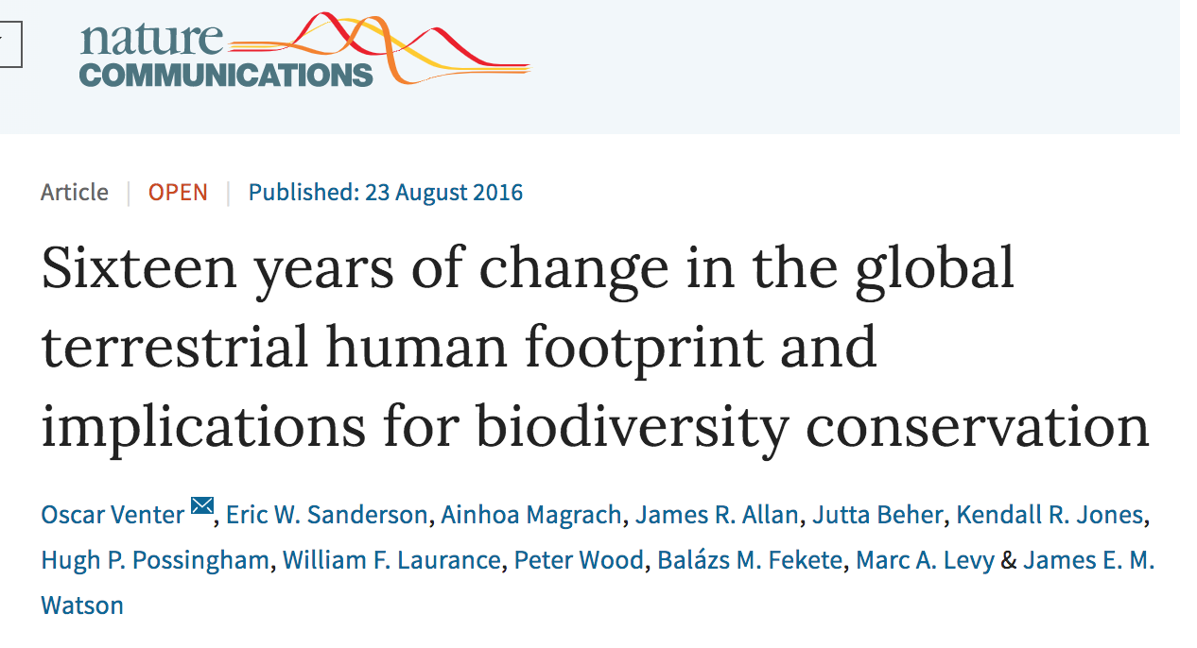
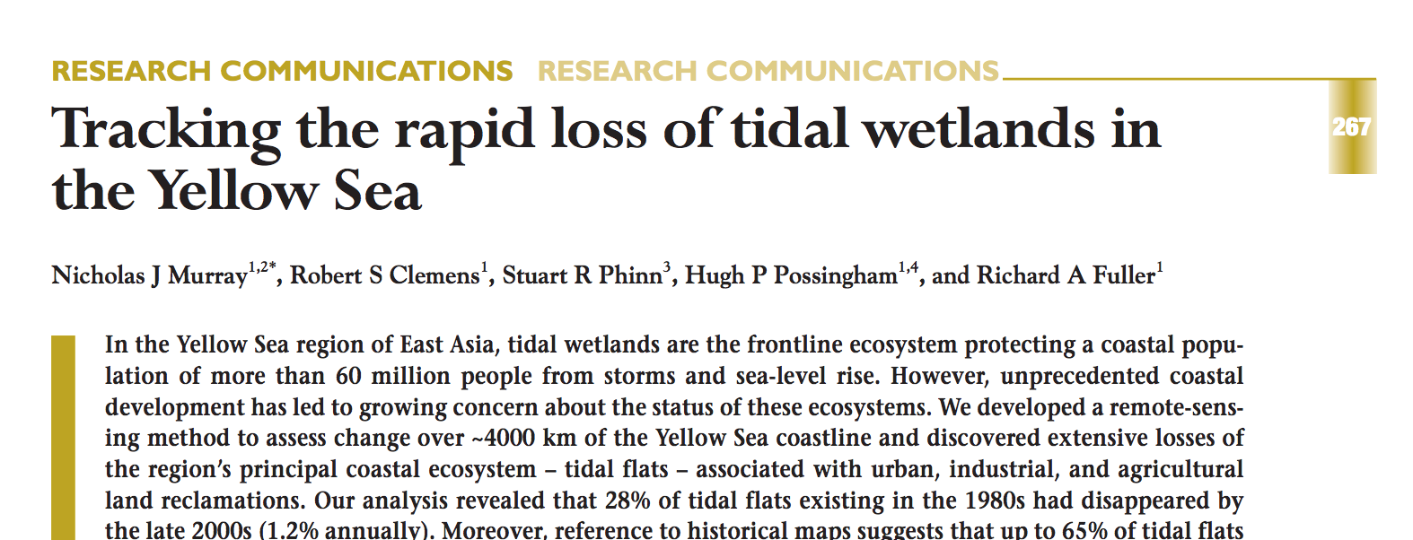
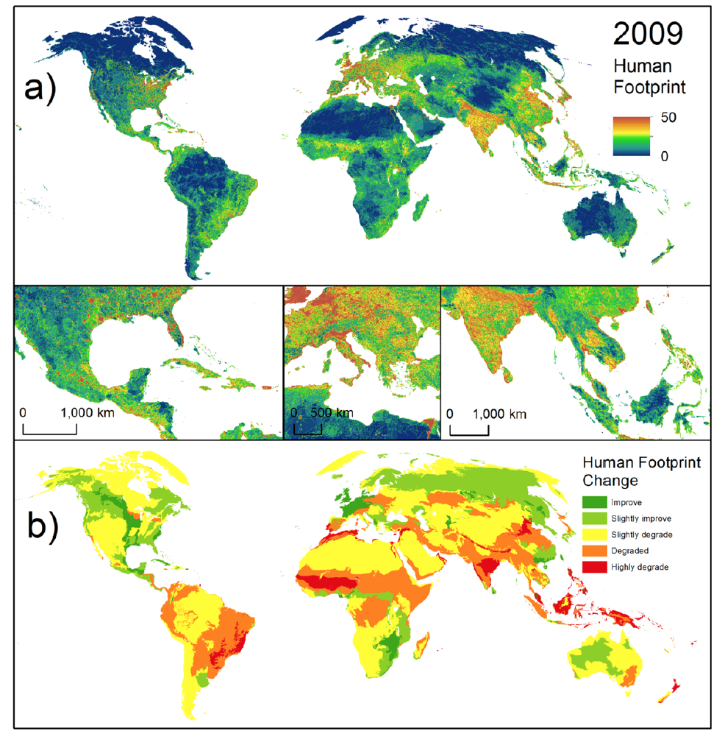
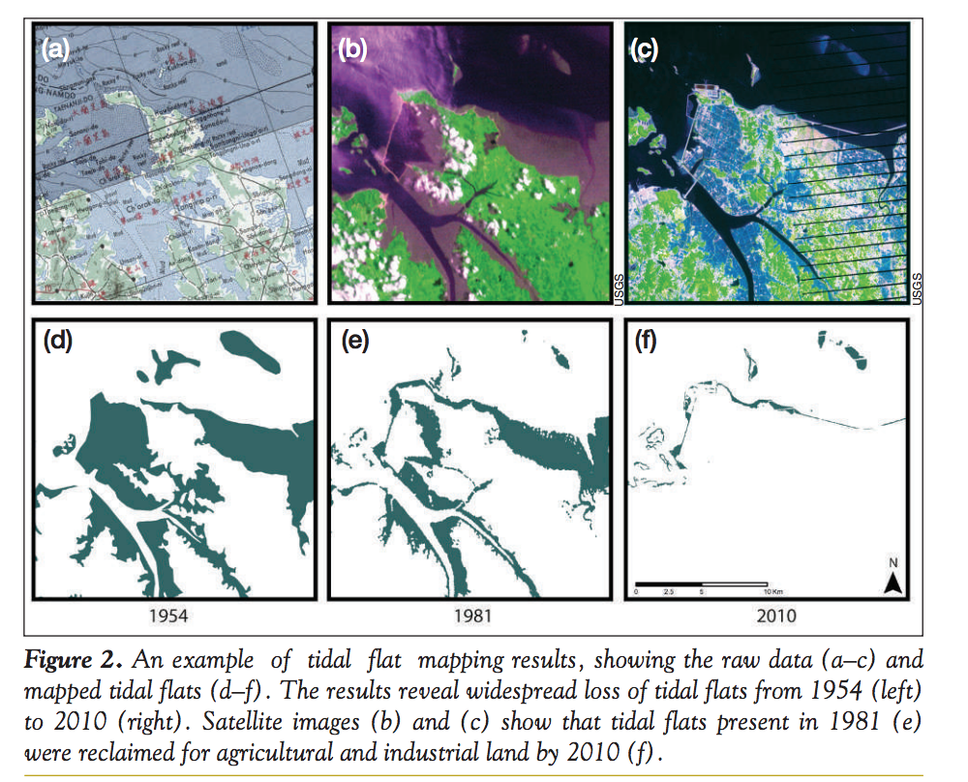
Observation: e.g. habitat loss
Notes:
Short overview of different papers – feel free to change/cut/add

Slide 4

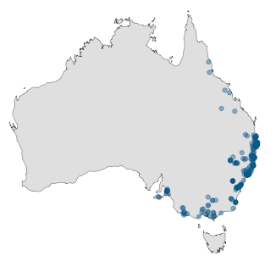
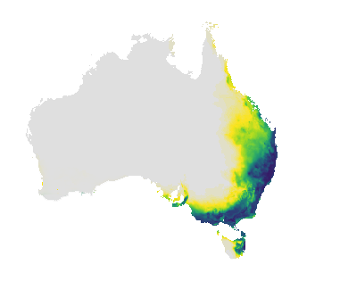

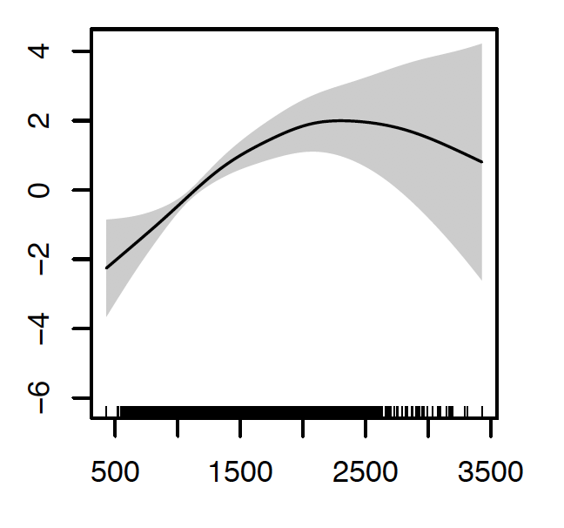
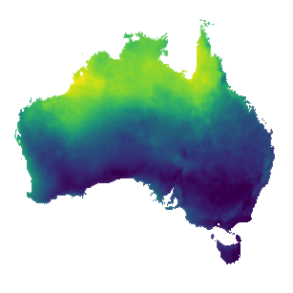
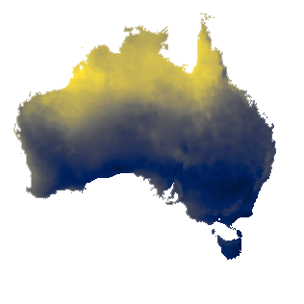
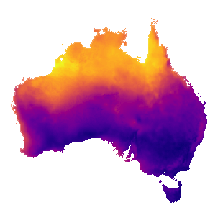
Species Distribution Modelling (SDM)
Species occurrence data
Predicted probability of occurrence
Statistical or ML model
Vegetation
Rainfall
Temperature
Environmental rasters

Slide 5
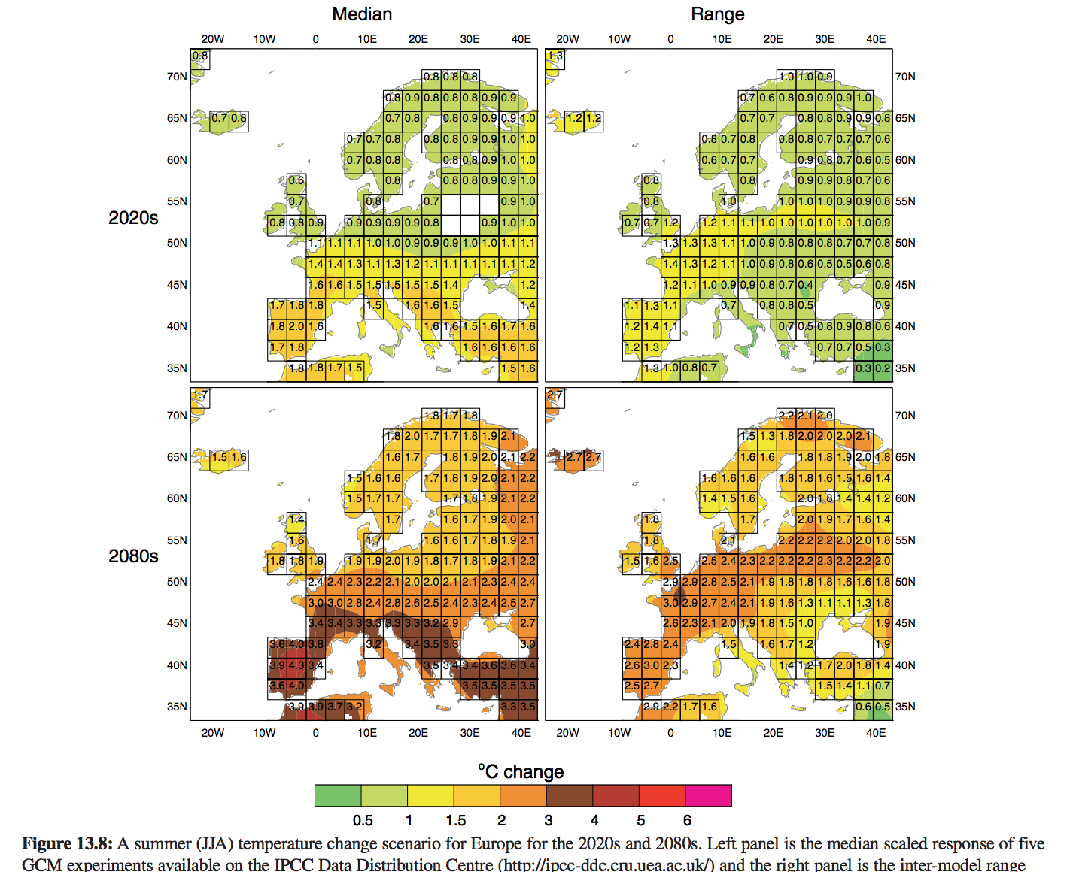
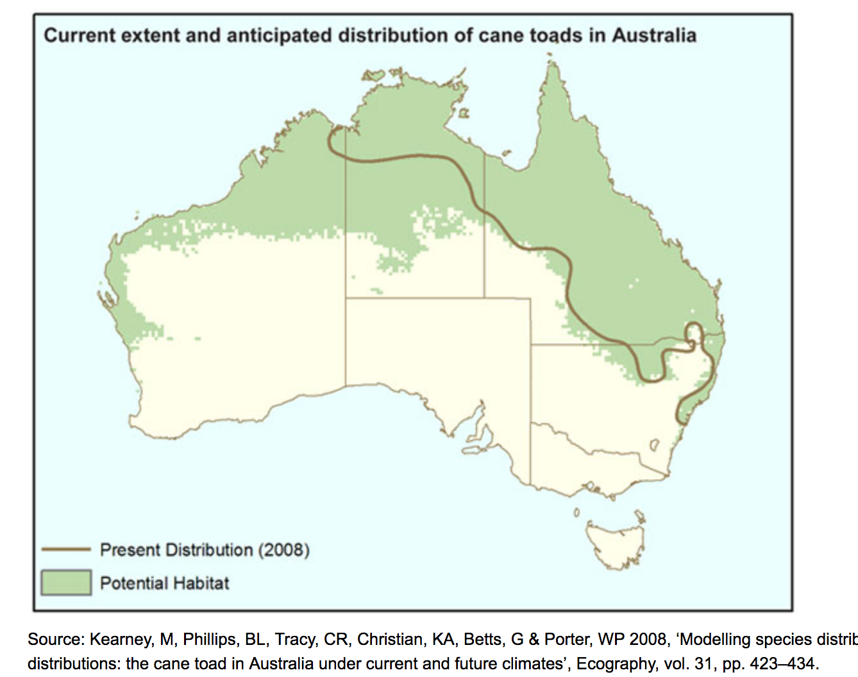
Prediction: SDM & climate

Slide 6
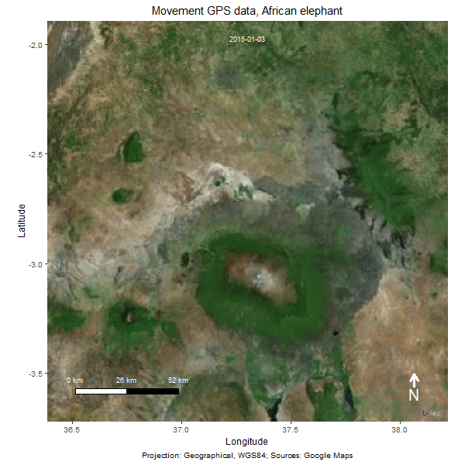
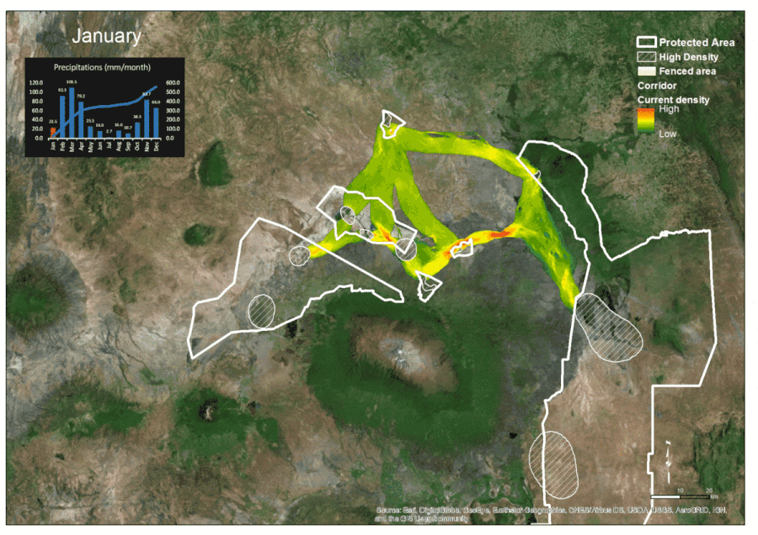
Using GPS track data to monitor wildlife
Predicted movement corridors
Osipova, et al., (2018) Using step-selection functions to model landscape connectivity for African elephants: accounting for variability across individuals and seasons. Animal Conservation.

Slide 7
Animated data
https://mseaclab.com/research/
https://youtu.be/nUKh0fr1Od8
Notes:
Please add some other cool stuff☺ - the links I have here would need to be visited online to play

Slide 8
What is the underlying “spatial analysis”:
What is close by? What is the consequence?
Distance & area calculations
extractions from surfaces
Interaction between layers
Layer 1
map
data
Layer 2
Computer
R
Layer 3
forest | 100 ha
urban | 1000 ha
Spatial data storage
Data preparation & analysis
Produce map or table as output
Notes:
Just to give an idea of the steps: usually data has to be prepared to be ready for analysis, and this is what half of the course is about

Slide 9
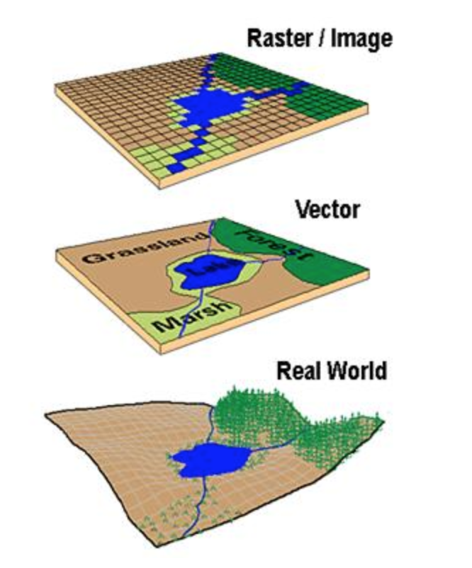
Most important concept: how to not mess my analysis up
Working with spatial data is like making a
sandwich: if the condiment is not put ON the
bread-roll, you make a mess!
Position: Sandwiches are stacks of flat (2D)
planes, but the world is round…
→ Projections of the world
Border-mismatch between data layers
→ Resolution
Notes:
Position is the broader position of the dataset in comparison to the real world (projection)
Border mismatch has something to do with the resolution of each dataset in comparison to each other and the real world (resolution that matches the analysis)

Slide 10
This is what you learn today
Basic concepts:
projections, types of data
Reading & Manipulating data
Creating new data, creating new info
Interaction of data
Extraction, clipping, combination
Plotting
Base plot and ggplot
Notes:
Just to make them aware of what is coming, maybe not needed?

Slide 11
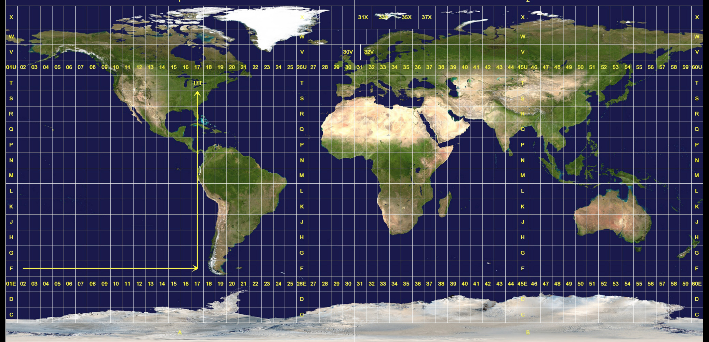
Earth = Orange peel
https://www.arcgis.com/apps/MapJournal/index.html?appid=31484c80dba54a058369dfb8e9ced549
https://www.jasondavies.com/maps/transition/
360
-180 0 180
Notes:
Thought to show some online little video here that shows how the earth peels open to become a mercator map, and the cool transition video from Roozbeh to give them an idea how different the world can be mapped

Slide 12
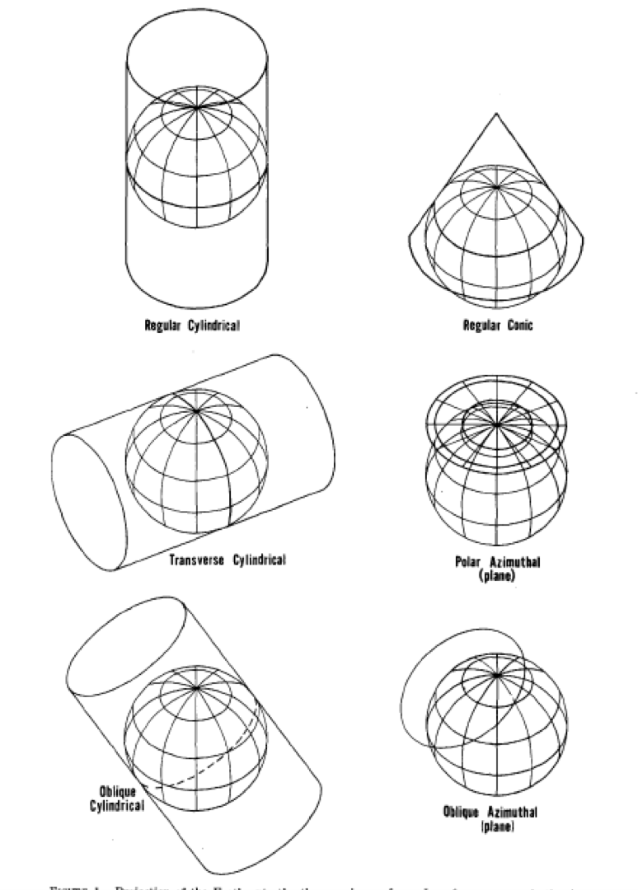
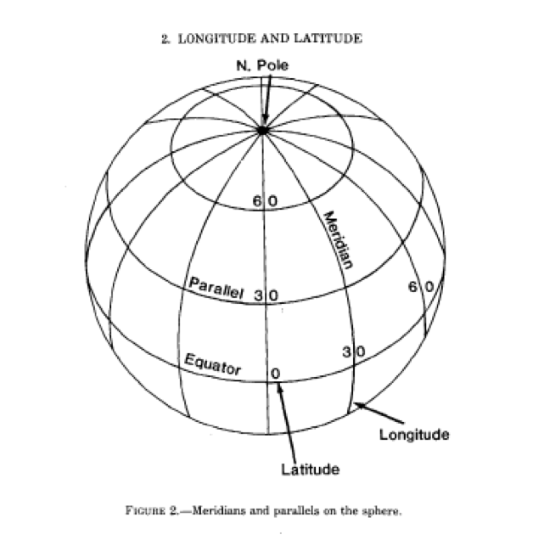
How to create a 2D map from a round-ish object
Regular cylindrical
Regular conic
Transverse cylindrical
Polar Azimuthal
Longitude
Latitude
Oblique Cylindrical
Oblique Azimuthal
Notes:
Basic idea of how the different maps get made, and what lat/long means

Slide 13
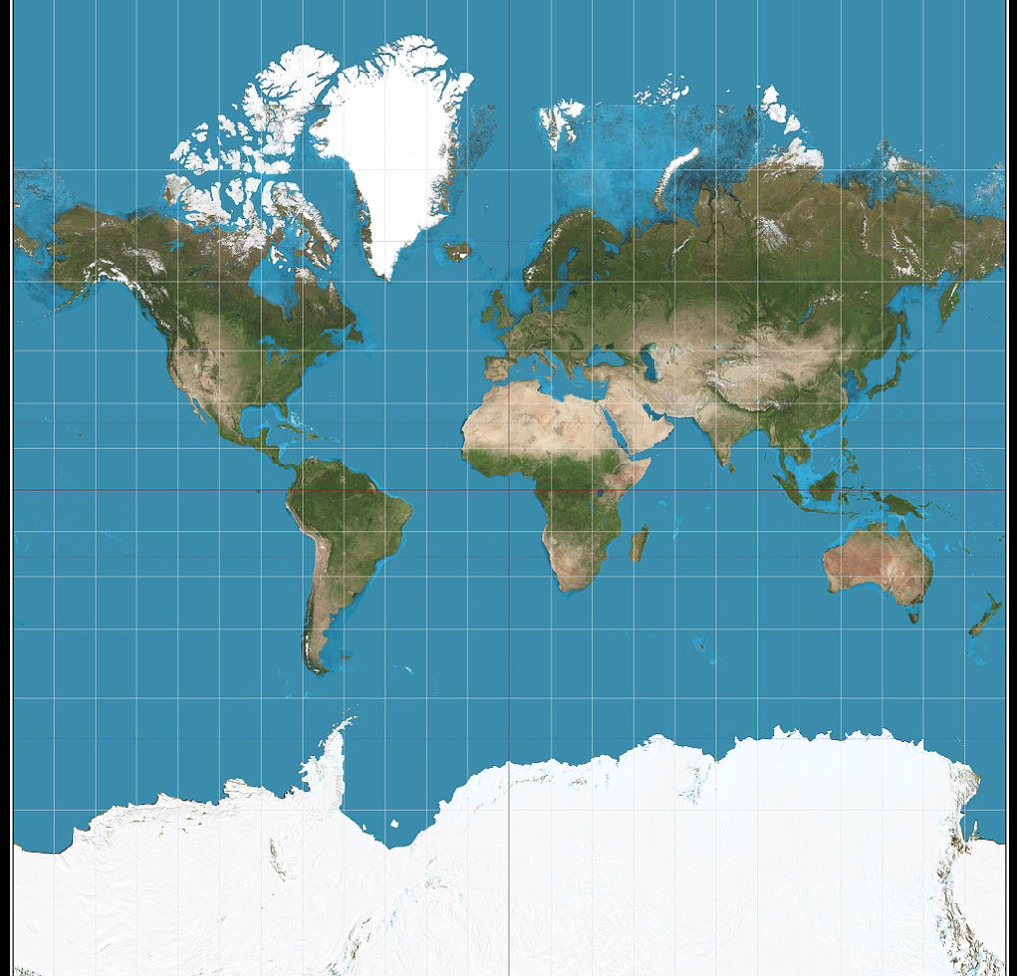
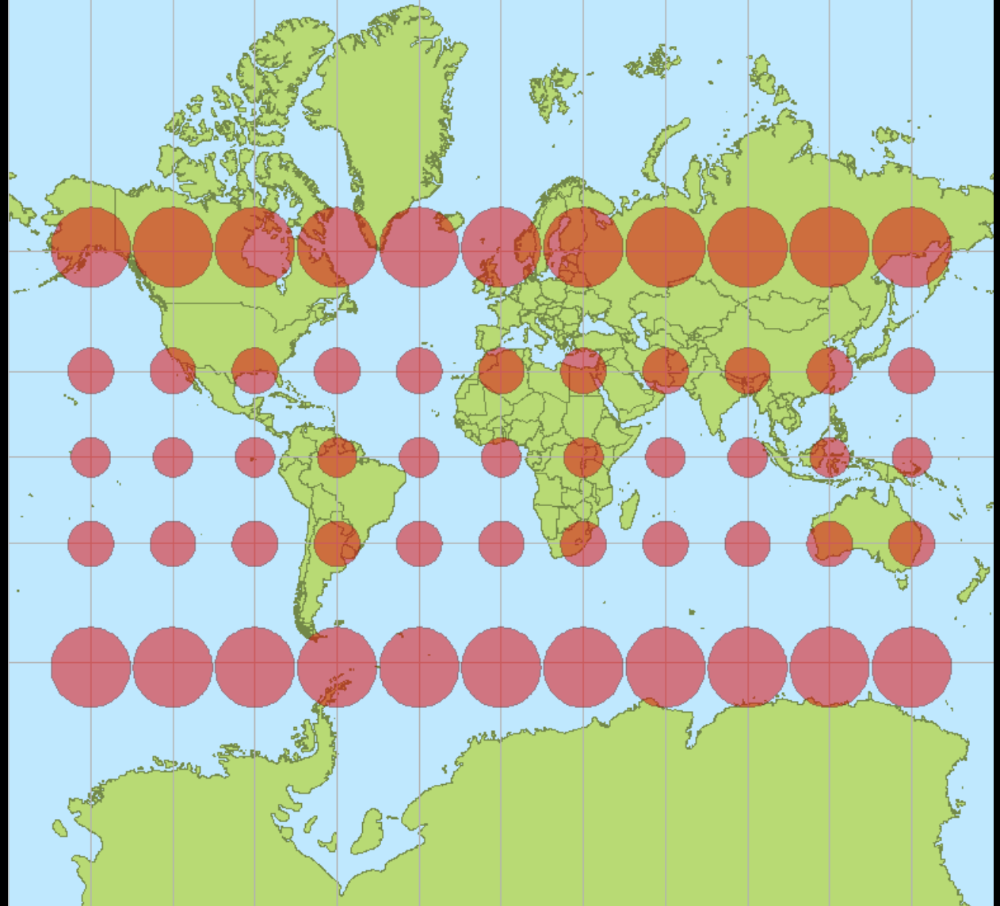
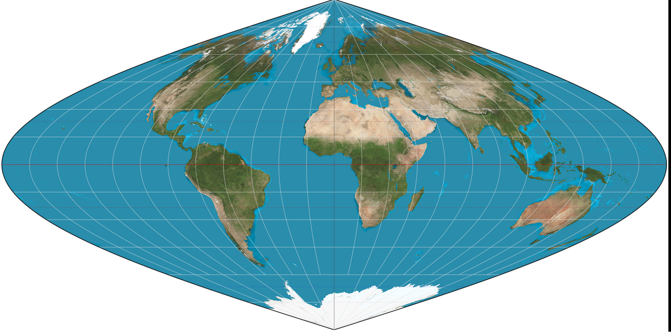
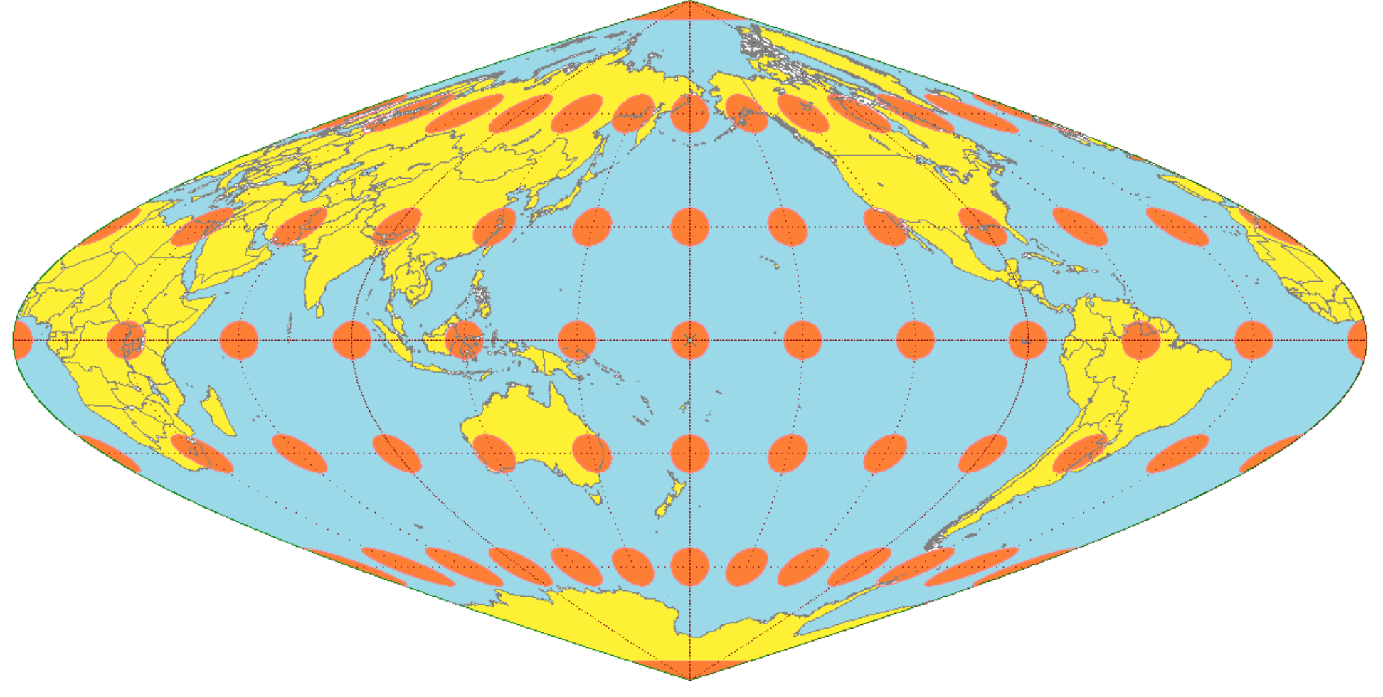
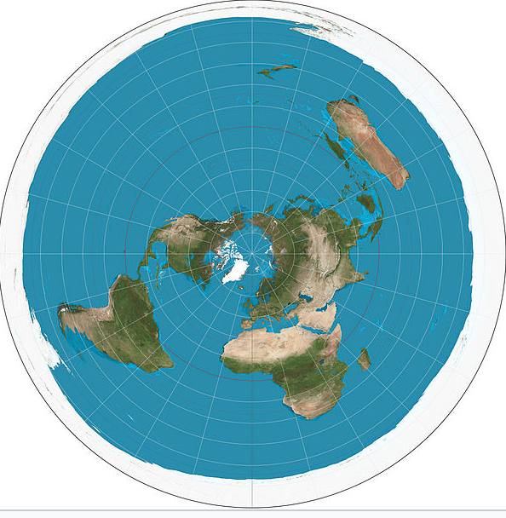
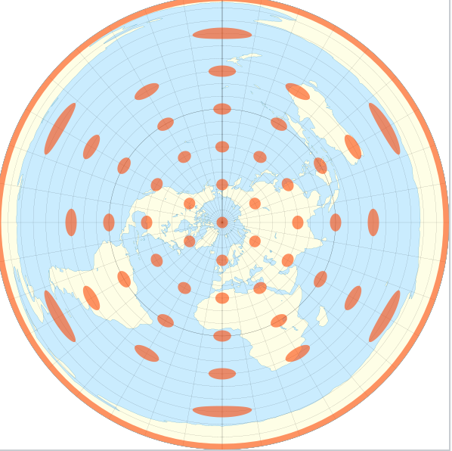
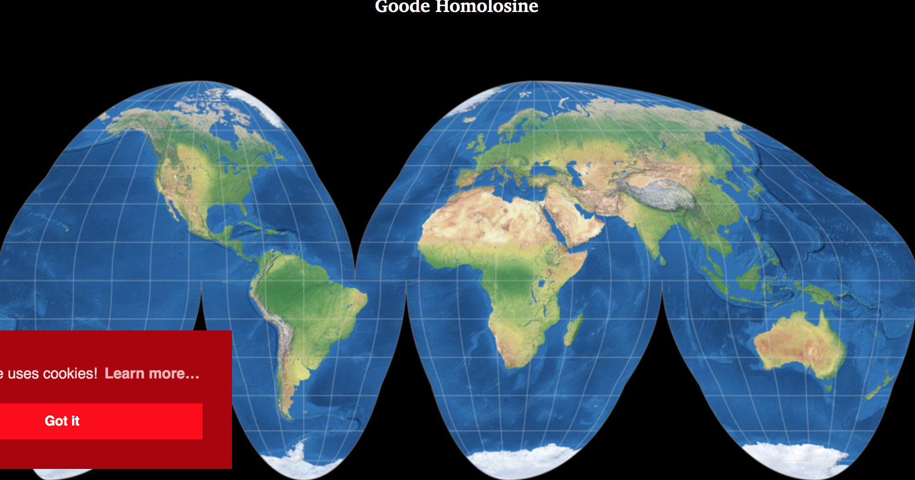
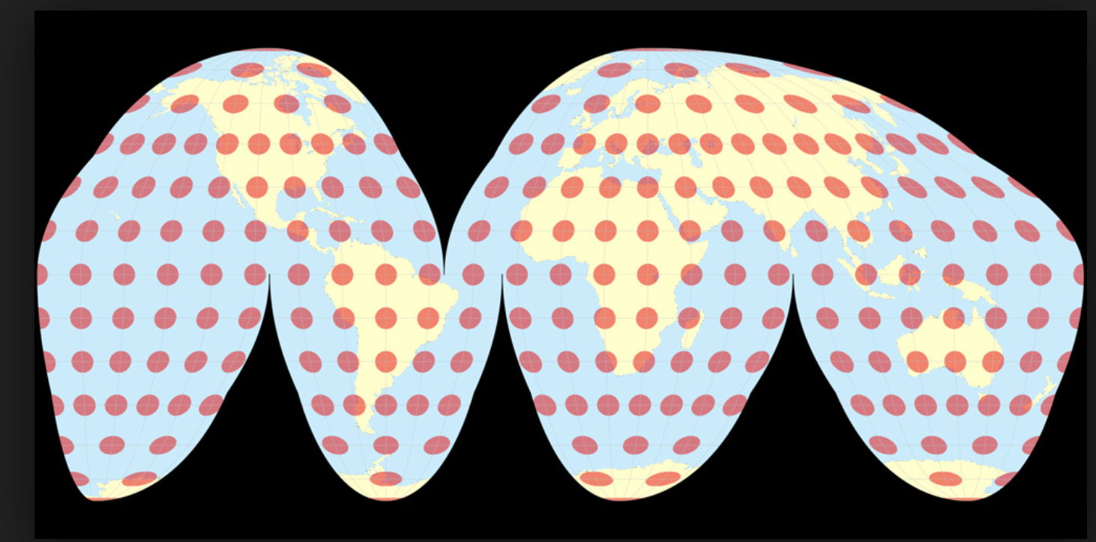
Angle, distance, area, direction
True angle (conformal)
True distance
True direction (azimuthal)
True area
Notes:
The 4 types of maps and what distortions mean

Slide 14
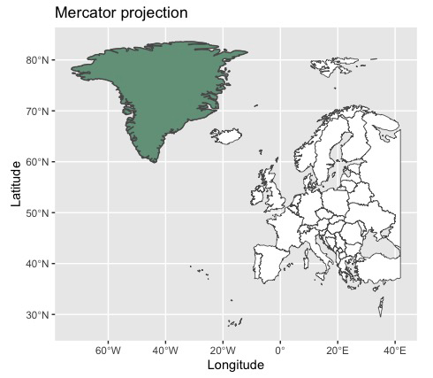
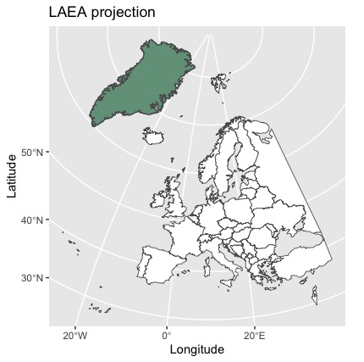
Projection
Mercator projection distorts the size of objects (area) as the latitude increases from the Equator to the poles.

Slide 15
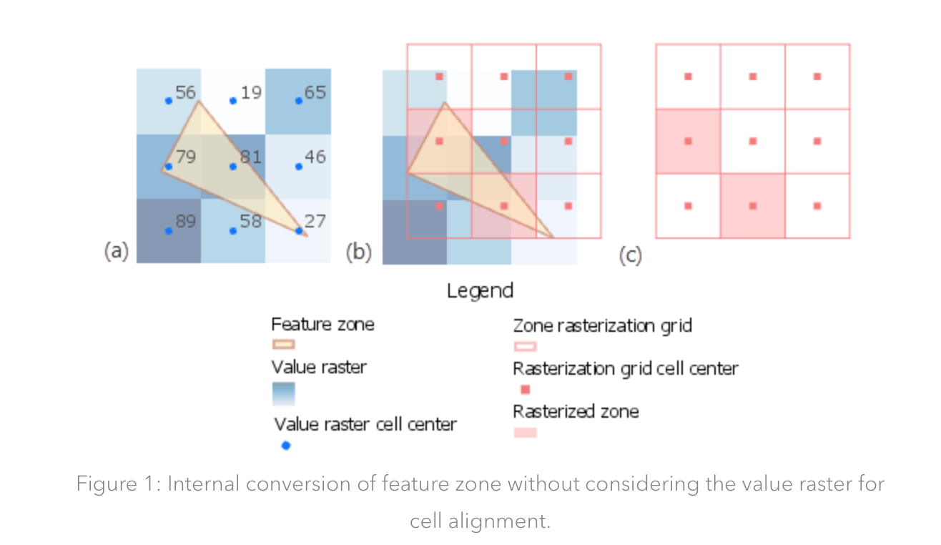
Overlay details matter!
Notes:
From https://www.esri.com/arcgis-blog/products/spatial-analyst/analytics/getting-the-most-out-of-zonal-statistics/
To talk about resolution match and why sometimes zooming in helps to understand if the data is good enough for the analysis that you want to do

Slide 16
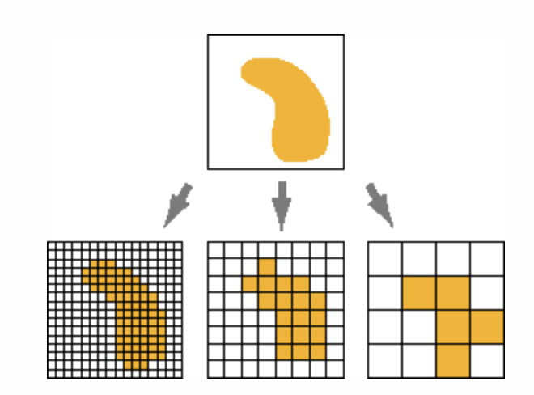
Data types & resolution: Raster
Resolution = size of cells
# rows
# columns
Tradeoff:
Accuracy
File size
Computing time
Notes:
Info about raster

Slide 17

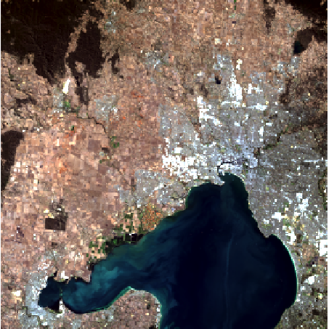
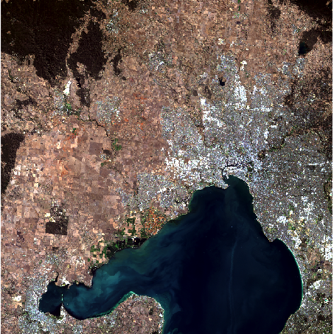
Spatial scale
Extent: Is data available across occurrence locations & landscape we want to predict to?
Grain/resolution: cell size, smallest unit. Does this match what we want to model (species) & our application?
Resolution
3000 x 3000 m
300x 300 m
30 x 30 m

Slide 18
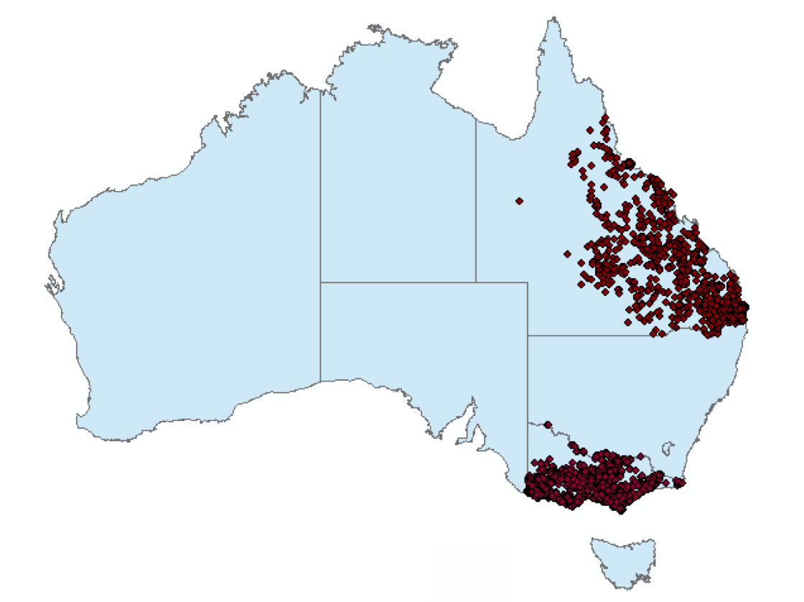
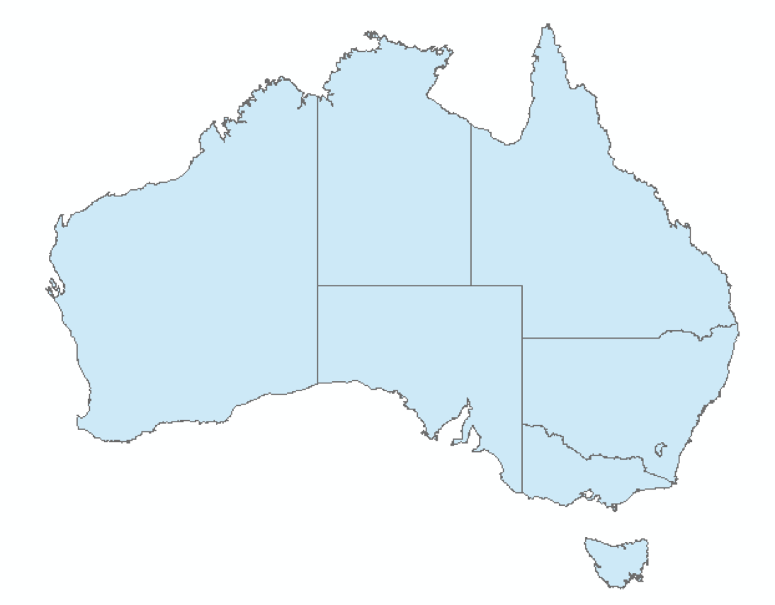
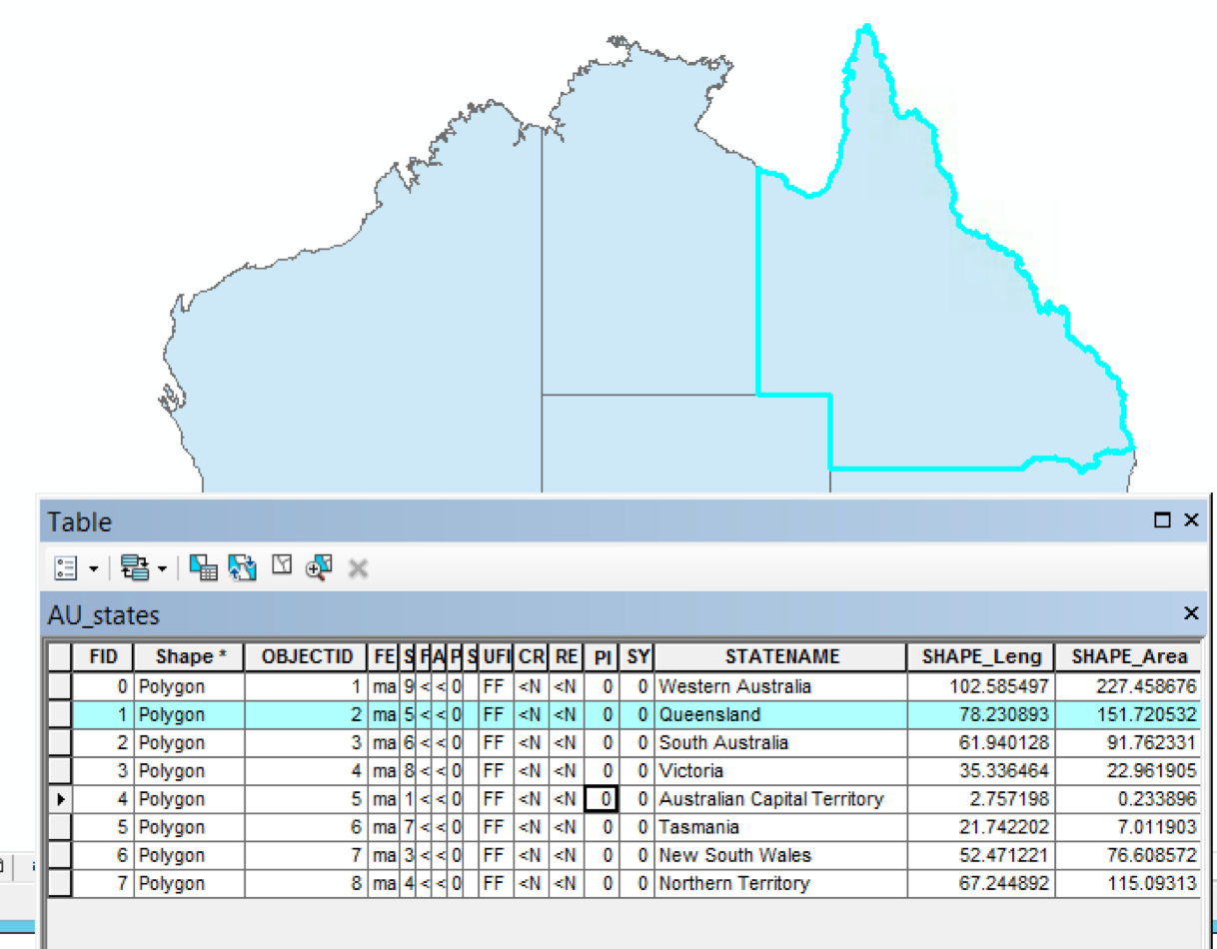
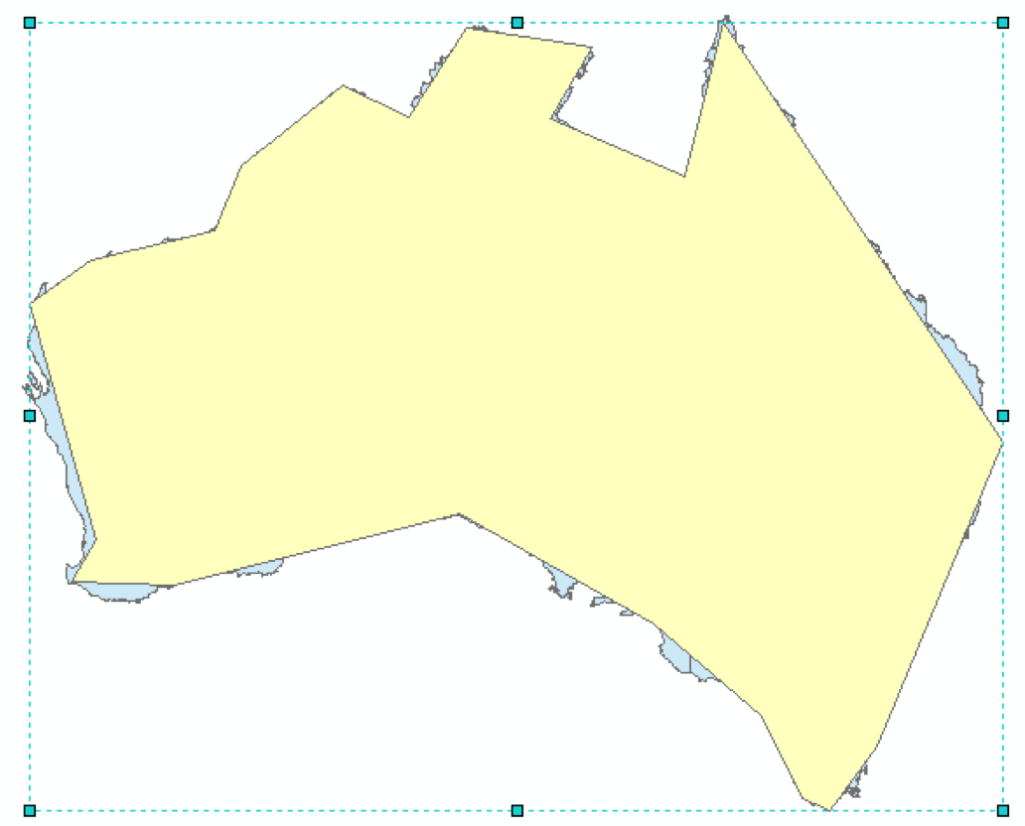
Data types & resolution: Vector
Tradeoff:
Accuracy
File size
Computing time
Notes:
Info about vector (points are the koala data from ALA)

Slide 19
Keep in mind:
Know your data! (and its limitation)
The question is as important as the data!
Explore / zoom / test if possible (check out QGIS?)
Pay attention to projections!
Notes:
summary

Slide 20
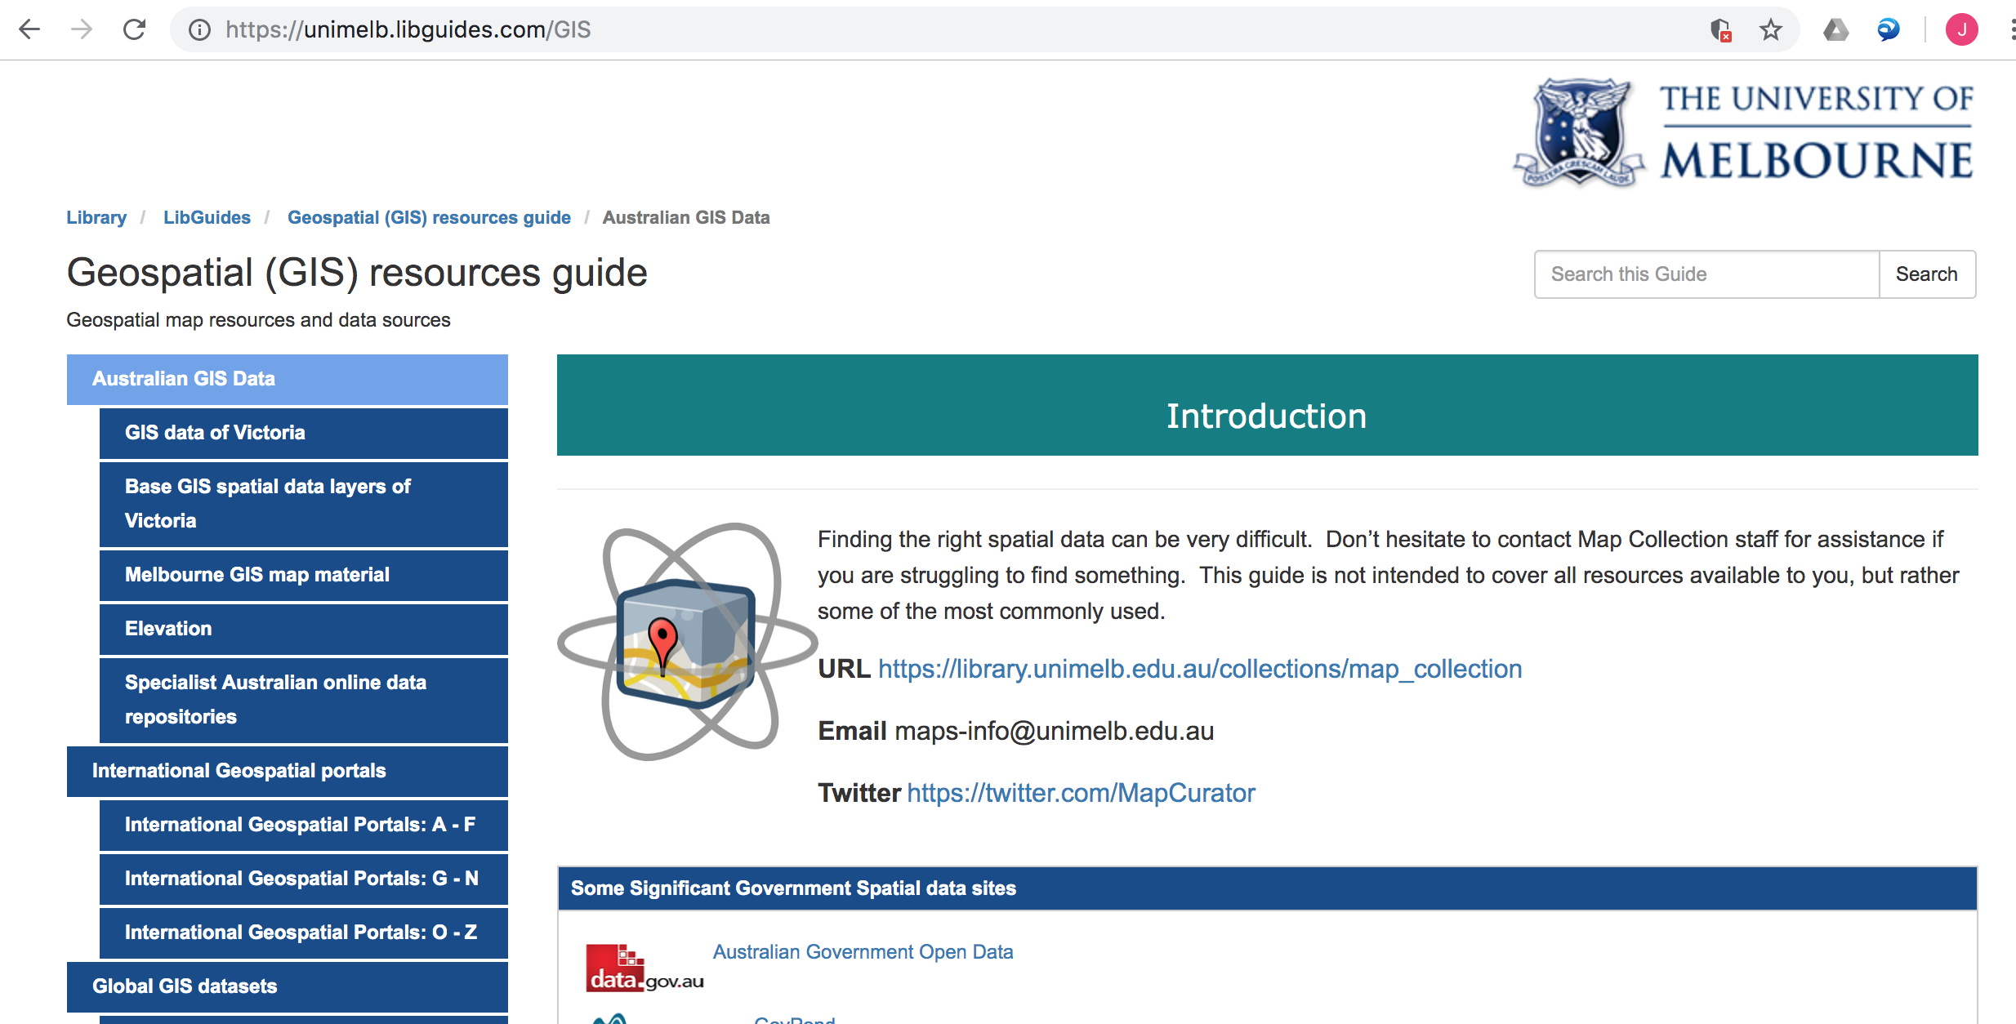
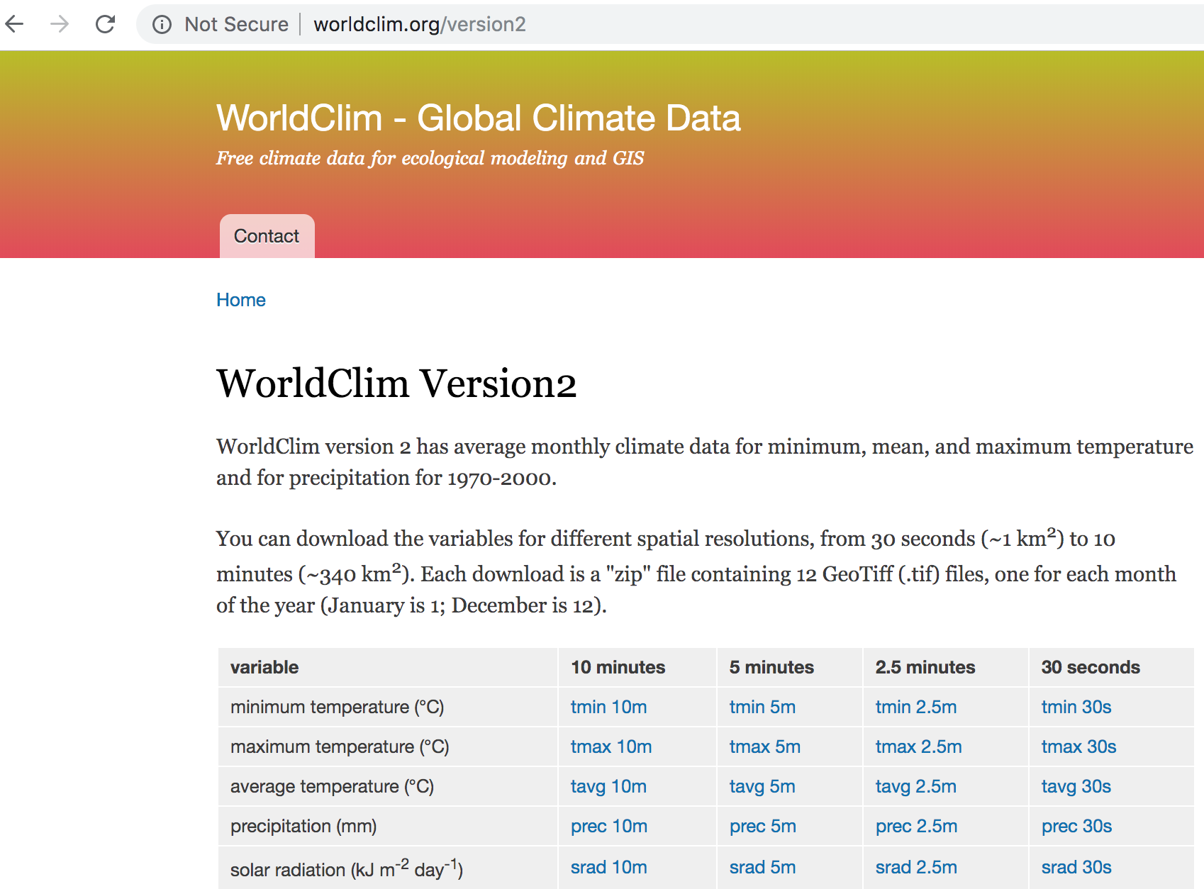
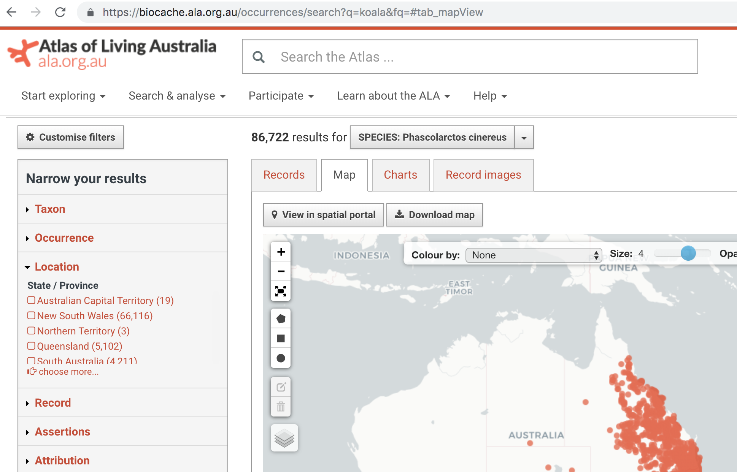
Online data
Notes:
Just to give an idea that there is a LOT of data

Slide 21
Now you’ll get your hands dirty
Commands to use:
…
…
…
Notes:
Maybe here to summarize the commands that we will use?

